Slide 1
INF 122 – Final Project Winter 2020
Joshua Garcia

Slide 2
Tile-Matching Game Environment (TMGE)
A tile-matching video game is a type of video game where the player manipulates tiles in order to make them disappear according to a matching criterion.
Notes:
https://tetris.com/article/38/how-to-get-better-at-tetris-practice-practice-practice
https://www.funstockretro.co.uk/news/bust-a-move-2-arcade-edition-playstation-think-you-can-beat-it/

Slide 3
Notes:
https://www.forbes.com/sites/isisbriones/2018/10/11/candy-crush-friends-saga-release-interview/#78dea7225031
https://thenextweb.com/syndication/2019/12/21/6-cheesy-life-lessons-that-playing-bejeweled-taught-me/
https://www.businessinsider.com/dr-mario-world-release-date-nintendo-2019-6

Slide 4
Final Project Description on Canvas

Slide 5
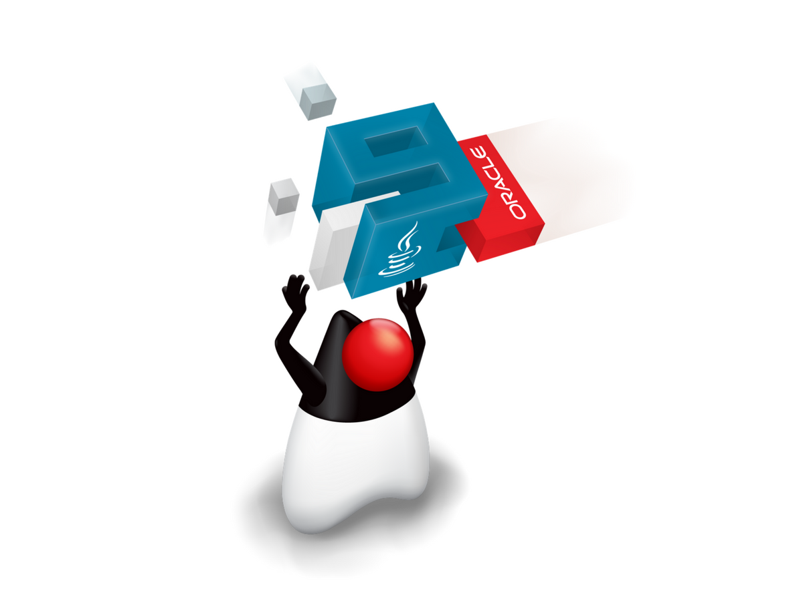
Architecture-Based Development Goes Mainstream
Bridge the gap between constructs at the architectural and implementation levels
At the programming-language Level
Architectural frameworks
Java gets explicit components through the Java Platform Module System (JPMS)
Notes:
To address this problem, the software engineering community has promoted the idea of architecture-based development, which bridges the abstraction gap between the programming-language level and the architecture level. For example, ArchJava actually provided a notion of software components and connectors to the Java language. Architectural frameworks like the C2 framework did this at a slightly higher level of abstraction giving you framework with components you can override.
After nearly two decades of this groundbreaking research, one of the most widely used programming languages in the world, Java, now bridges the gap between architecture and implementations. Java now provides explicit component-based development through the Java Platform Module System
Variety → addressing
Re-visit→ recent drastic
Provides
Introduces notions
Possible → resolve arch incon more accurately

Slide 6


Java Platform Module System - A Drastic Change to Java
Java Platform Module System
Encapsulation of traditional Java programming-language constructs
Rich software architectural interfaces
in
Java 9
Notes:
The Java Platform Module System (JPMS), introduced in Java 9, is drastic change to Java. Not only does it give you explicit components at the programming-language level, it gives you rich architectural interfaces for them. It even forces you to modularize your project in some way, even if you create a monolithic component for which everything is accessible.
Good news
…
Explicit support for component-based development
Software components (modules)
Explicit architectural interfaces and dependencies

Slide 7
Module Descriptor
A filed called module-info.java with
Module declarations
Module dependencies
Module
Package 1
Package 2
Type1
Type2
Type3
Type4
Type5
Type6
Module Descriptor
Module-info.java
Data + Resources
Notes:
Before I introduce those inconsistency types, it is important that you understand how modules in Java work. Modules are specified in descriptor files entitled module-info with a .java extension, or simply module-info.java.

Slide 8
Module Declaration
The module declaration’s body can be empty or may contain various module directives
module modulename {
/* A set of dependencies */
}
Notes:
Modules in the descriptor files are declared using the keyword module and followed by a unique modulename and a body, describing its set of dependencies.
body can be EMPTY or contain a set of dep → specifies EXPOSURE / NEEDS ACCESS TO

Slide 9
Module Dependencies
requires
exports
Module Directives
opens
uses
provides
Notes:
A module body can utilize COMBINATIONS OF 5 module directives, which are used to specify module dependencies. I’ll talk about each of these directives in turn.
These directives include … → explain one by one with example

Slide 10
Module Dependencies
requires
A list of modules it depends on
module foo{
requires java.logging;
requires transitive bar;}
Module Directives
Module: foo
requires transitive
Module: bar
…
…
requires
JDK Module: java.logging
Notes:
The requires directive of a module specifies the other modules that it depends on. For example, here, foo depends on the JDK module java.logging and the module bar, and all the other modules that bar transitively depends on.

Slide 11
Module Dependencies
requires
A list of modules it depends on
exports
module foo{
exports com.foo.utils;
exports com.foo.internal to bar;}
A list of packages other modules can use
Module Directives
exports
to
Module: foo
Module: bar
exports
…
com.foo.utils
com.foo.internal
Notes:
The exports directive of a modules specifies the packages the module exposes to other modules. In this example, foo exports com.foo.utils to all modules and com.foo.internal to module bar.
specifies one of the module’s packages WHOSE public & protected types should be accessible to code in all other modules

Slide 12
Module Dependencies
requires
A list of modules it depends on
exports
A list of packages other modules can use
module foo{
opens com.foo.network;
opens com.foo.exnet to bar;}
open module foo{
...
}
Module Directives
opens
A list of packages other modules can use via reflection
opens
to
Module: foo
Module: foo
Module: bar
opens
opens
…
com.foo.network
com.foo.network
opens
com.foo.exnet
com.foo.internal
Notes:
The opens directive of a module indicates that a specific package’s public, protected and even private types are accessible at runtime via reflection. Here, com.foo.network is exposed for reflective access to all modules while com.foo.exnet is only reflectively accessible by module bar.
We can also use open as a modifier to a module making all of its contents accessible using reflection.
---------
Open the entire module

Slide 13
Module Dependencies
requires
A list of modules it depends on
exports
A list of packages other modules can use
Module: Service
module foo{
requires Service;
uses com.service.Srv; }
module bar{
requires Service;
provides com.service.Srv with
com.bar.impl.ImplSrv; }
Module Directives
opens
com.service.Srv
A list of packages other modules can use via reflection
uses, requires
uses
provides, requires
A list of services it consumes
Module: foo
Module: bar
provides
…
A list of implementations for services it offers
com.bar.impl
Notes:
The uses and provides directives of a module are similar to interface types. Uses specifies the services a module consumes and provides specifies the services a module offers. For example, module foo uses com.service.Srv which module bar provides using com.bar.impl.ImplvSrv as a specific implementation of com.service.Srv

